Slide 1
Nuclear Physics: An Engineering Perspective
Part II

Slide 2
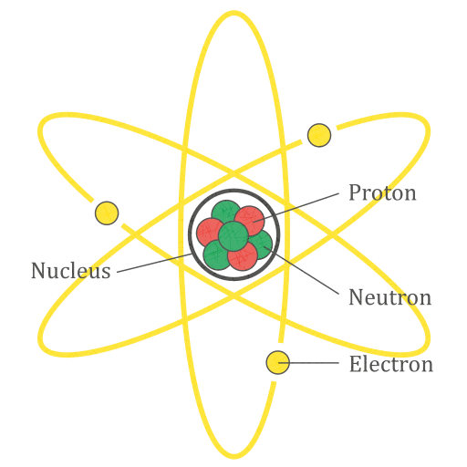
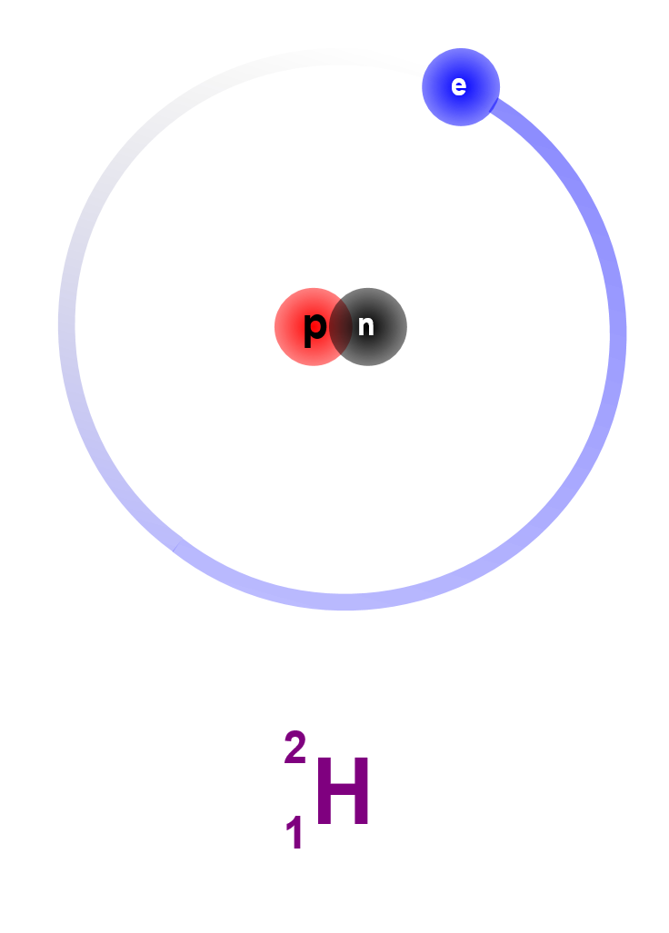
Review: Atomic Structure
# of protons determines element
# of neutrons determines isotope
Mass Number (Z+N)
Protons (Z)
Element

Slide 3
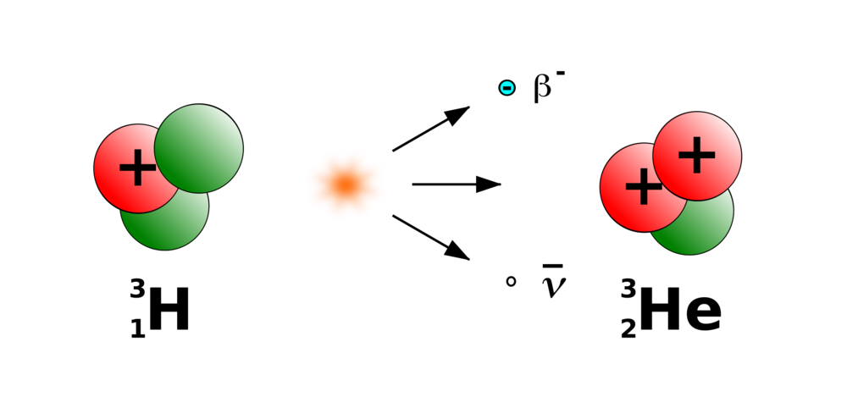

Review: β Decay
Some isotopes are unstable, that is, they decay into other isotopes
${}_{1}^{3}H\overset{→}{}{}_{2}^{3}{He}+e^{−}+\overline{{\text{ν}}_{e}}$
A neutron turns into a proton, releasing a beta particle (electron)
Also an electron antineutrino ($\overline{ν_{e}}$), but that’s less important for nuclear physics

Slide 4
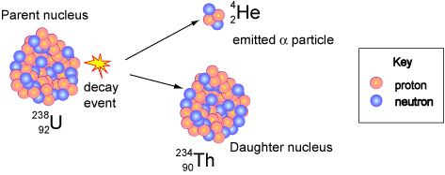

α Decay
Mostly occurs in large atoms
E.g., Polonium-210, Americium-241
2 protons & 2 neutrons break off as an alpha particle
Element number -2, mass number -4
α particle = ${}_{2}^{4}{He}$ nucleus

Slide 5
γ Radiation
Not a particle like α and β
Electromagnetic radiation
Like light, radio, etc.
Doesn’t transmute nucleus
Basically a way for atoms to get rid of extra energy
When atoms undergo decay, the products can end up in excited states (too much energy)
They can get rid of this energy by emitting γ rays (get to ground state)

Slide 6
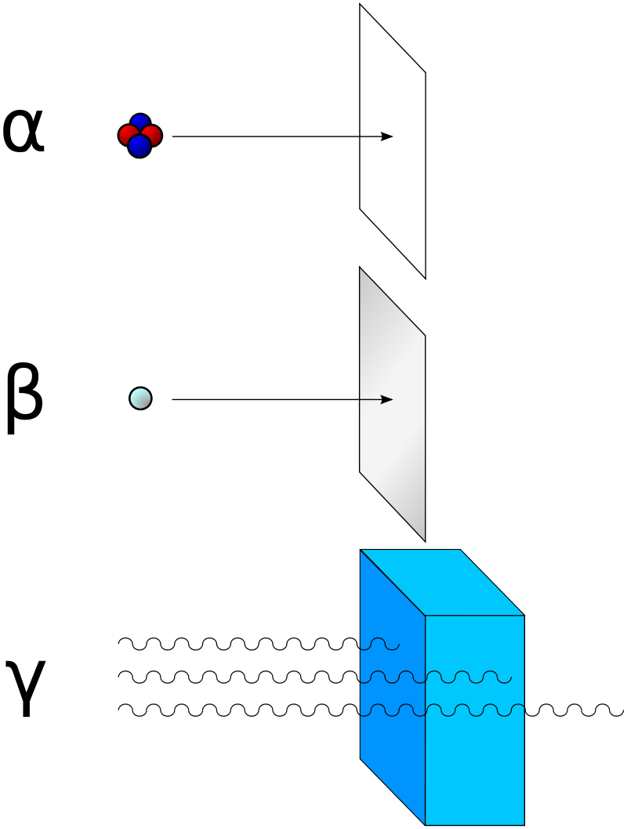
Radiation Penetration

Slide 7
Half Life
Start
64
64/2=32
Round 1
32
32
Round 2
32/2=16
16
48
16/2=8
Round 3
8
56
8/2=4
Round 4

Slide 8
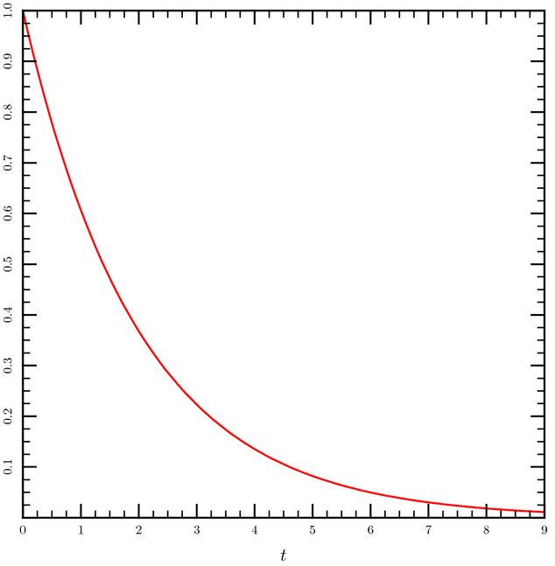

Half Life
Half life = the time it takes for half the atoms to decay
$N\left(t\right)= N_{0}⋅{\left(0.5\right)}^{\frac{t}{t_{1/2}}}$
($t_{1/2}$ is the half-life)

Slide 9

Half Life
Decay rate, or activity, is measured in Curies (Ci)
1 Curie is $3.7⋅{10}^{10}$ decays per second
Note that the activity is the rate-of-change of atoms
And therefore the derivative of the exponential decay function

Slide 10

Half Life
For example, ${}_{27}^{60}{Co}$ has a half-life of 5.27 years
If you start with a mole of ${}_{27}^{60}{Co}$, after 5.27 years, you will have 0.5 mol of ${}_{27}^{60}{Co}$ and 0.5 mol of (stable) ${}_{28}^{60}{Ni}$
The activity will also drop by half

Slide 11
Decay Schemes
Okay, we know about different kinds of decay, and how fast it happens (half-life).
How do specific isotopes decay into others?

Slide 12
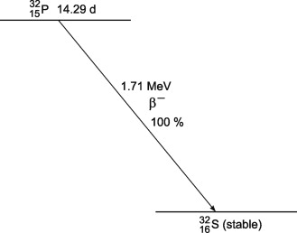
Decay Schemes
Initial isotope
Half-life
Decay mode
Energy
Decay type
% of atoms that take this route
Stable isotope(s)

Slide 13
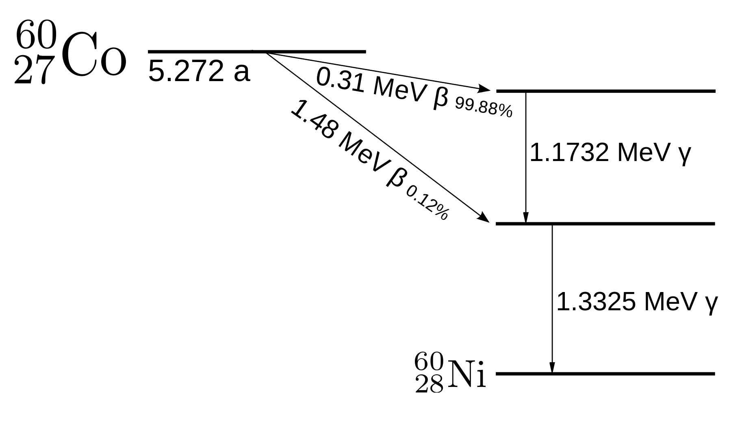
Decay Schemes

Slide 14
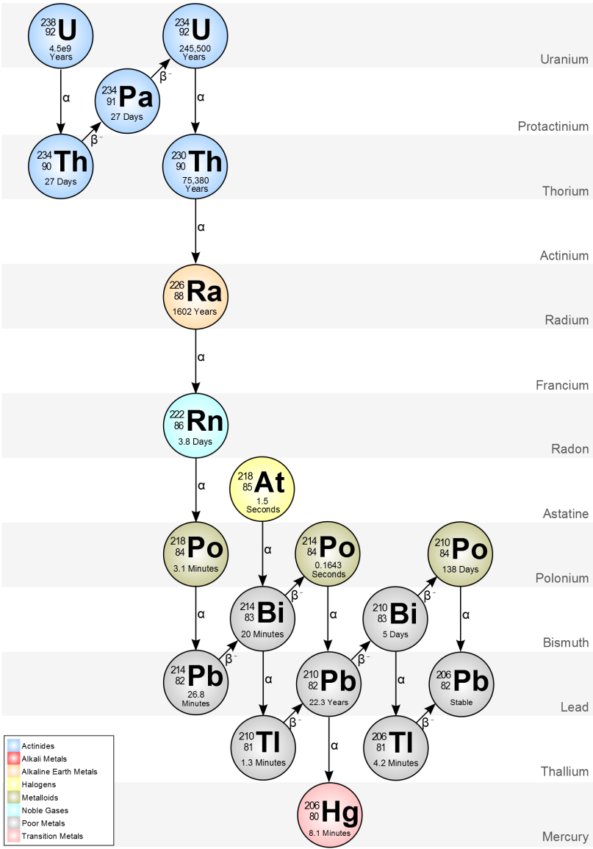
Decay Schemes

Slide 15
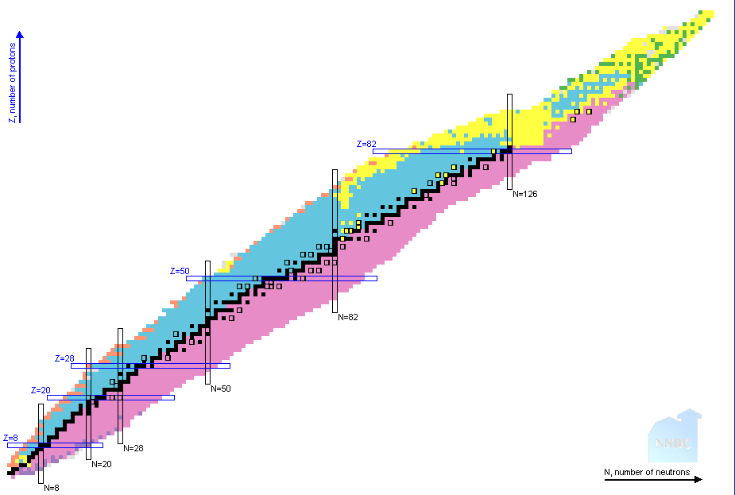

Table of Nuclides
(Nuclide is basically a synonym for isotope)

Slide 16
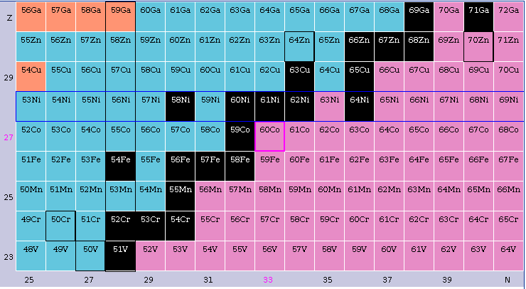
Table of Nuclides
https://www.nndc.bnl.gov/nudat2/index.jsp

Slide 17
Nuclear Reactions
So far, we’ve talked about radioactive decay
Some isotopes are unstable, and will decay to other isotopes with a certain probability (the half-life)
There’s not much that can be done about this

Slide 18
Nuclear Reactions
How can we cause changes to atoms?
The main way to intentionally modify atoms starts with adding one or more neutrons.

Slide 19

Nuclear Reactions
Example: We start with ${}_{79}^{197}{Au}$
This is normal, stable gold
Then we fire a neutron at it!
Suppose the neutron get captured by the ${}_{79}^{197}{Au}$ nucleus
The probability of this depends on the neutron cross section
(Roughly, how big the nucleus “looks” to the neutron)

Slide 20

Nuclear Reactions
We have now produced ${}_{79}^{198}{Au}$!
${}_{79}^{197}{Au}+{}_{0}^{1}n→{}_{79}^{198}{Au}+ γ$
This is an unstable isotope of gold

Slide 21
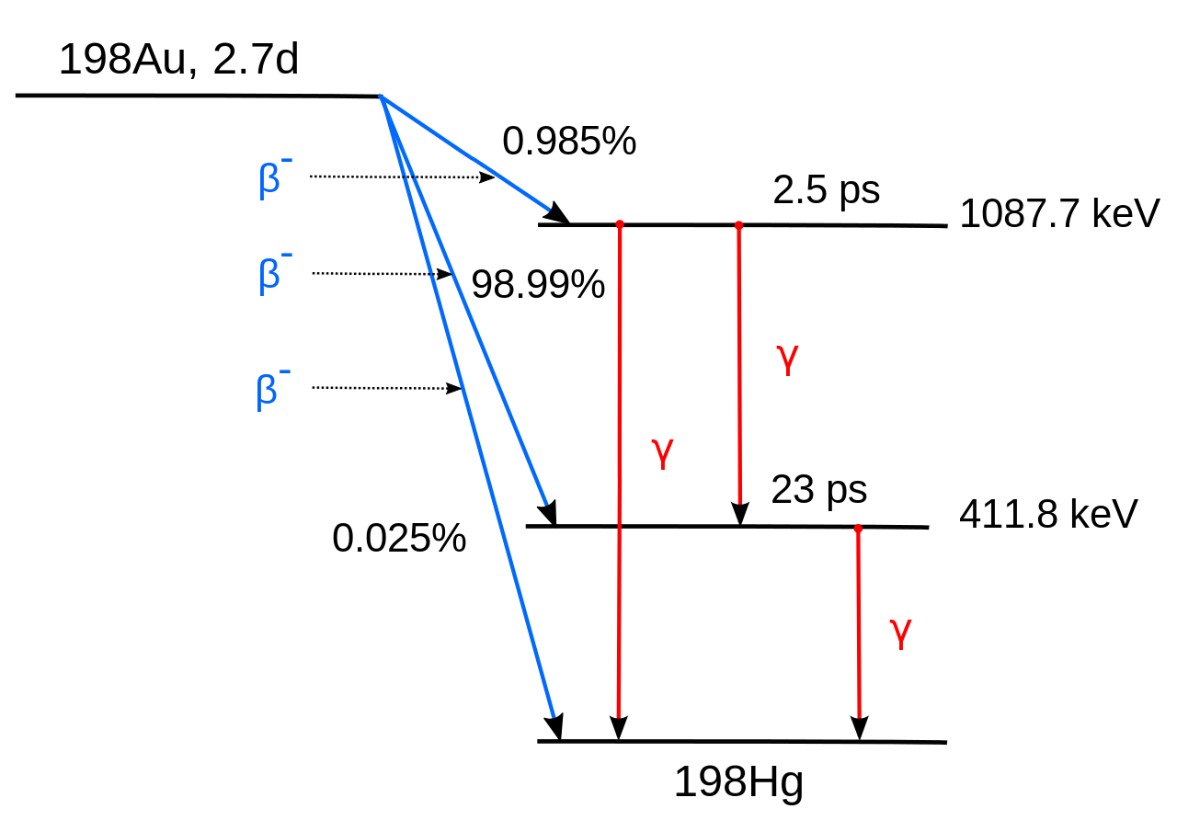
Nuclear Reactions

Slide 22

Nuclear Reactions
Example: https://www.youtube.com/watch?v=RKyIm-o30GE
This is extremely powerful
Through the use of neutrons, we have:
Turned stable gold into radioactive gold
Eventually turned gold into an entirely different element $\left({}_{80}^{198}{Hg}\right)$
You can’t do that in chemistry!
Conclusion: in nuclear reactions, neutrons are everything

